Slide 1
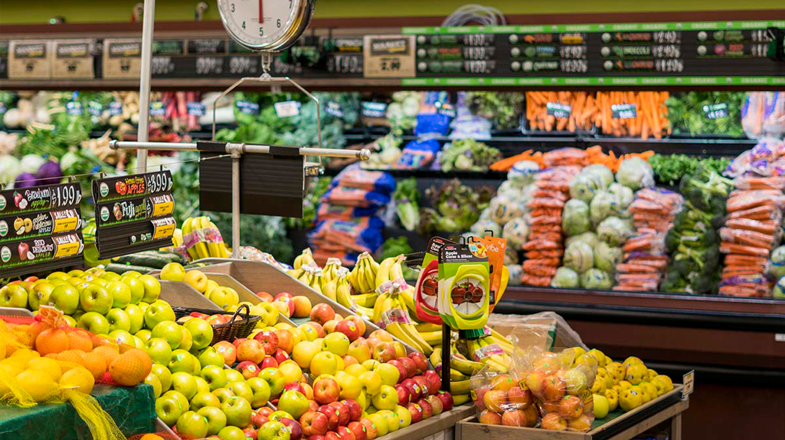

Slide 2
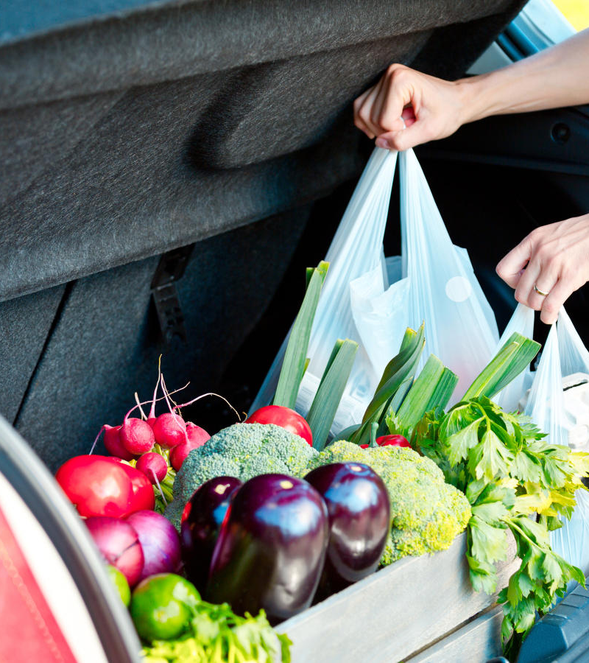


Slide 3
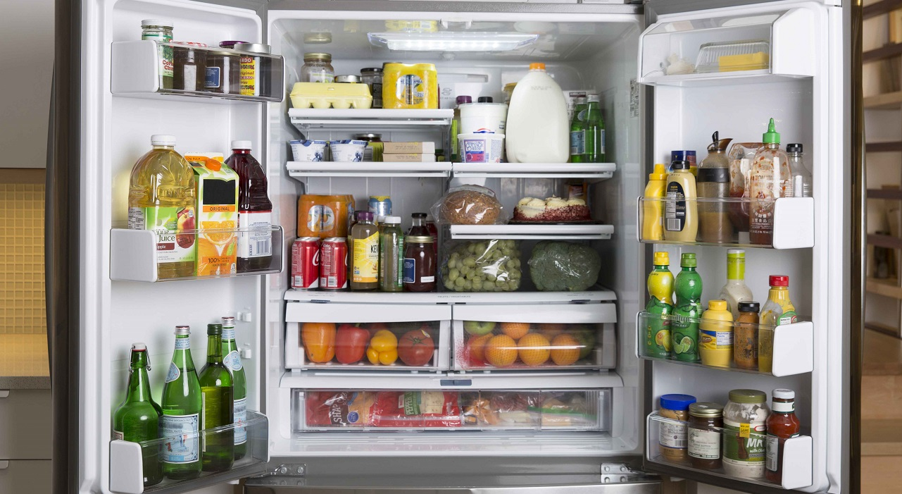

Slide 4
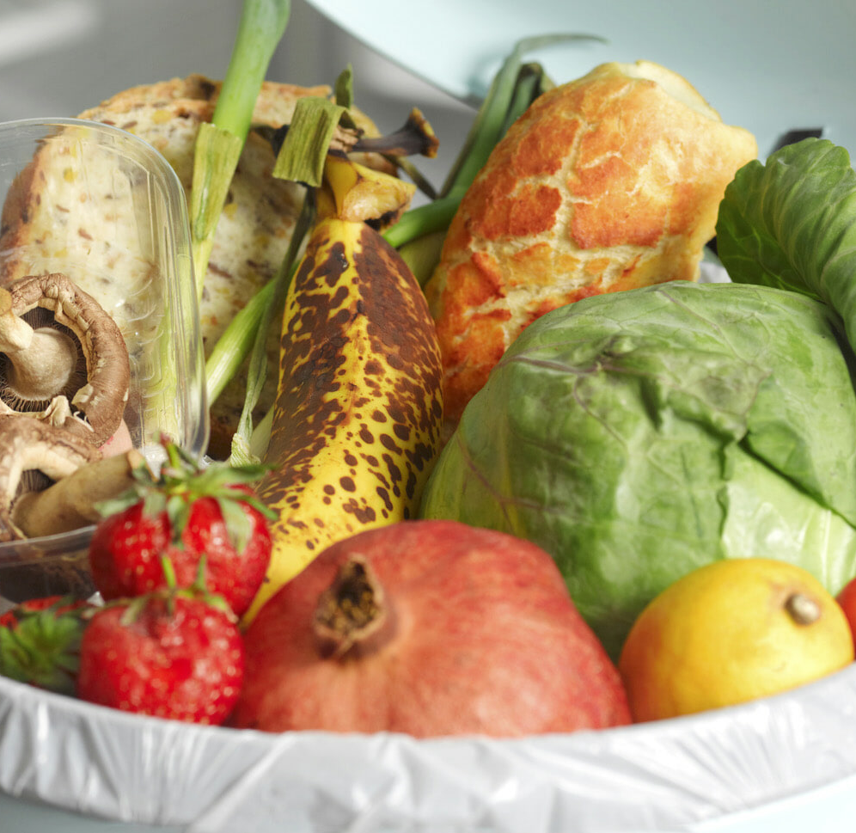
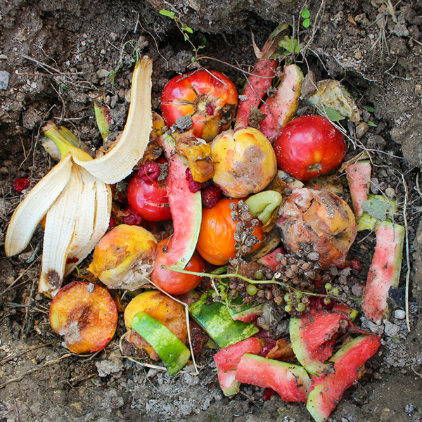
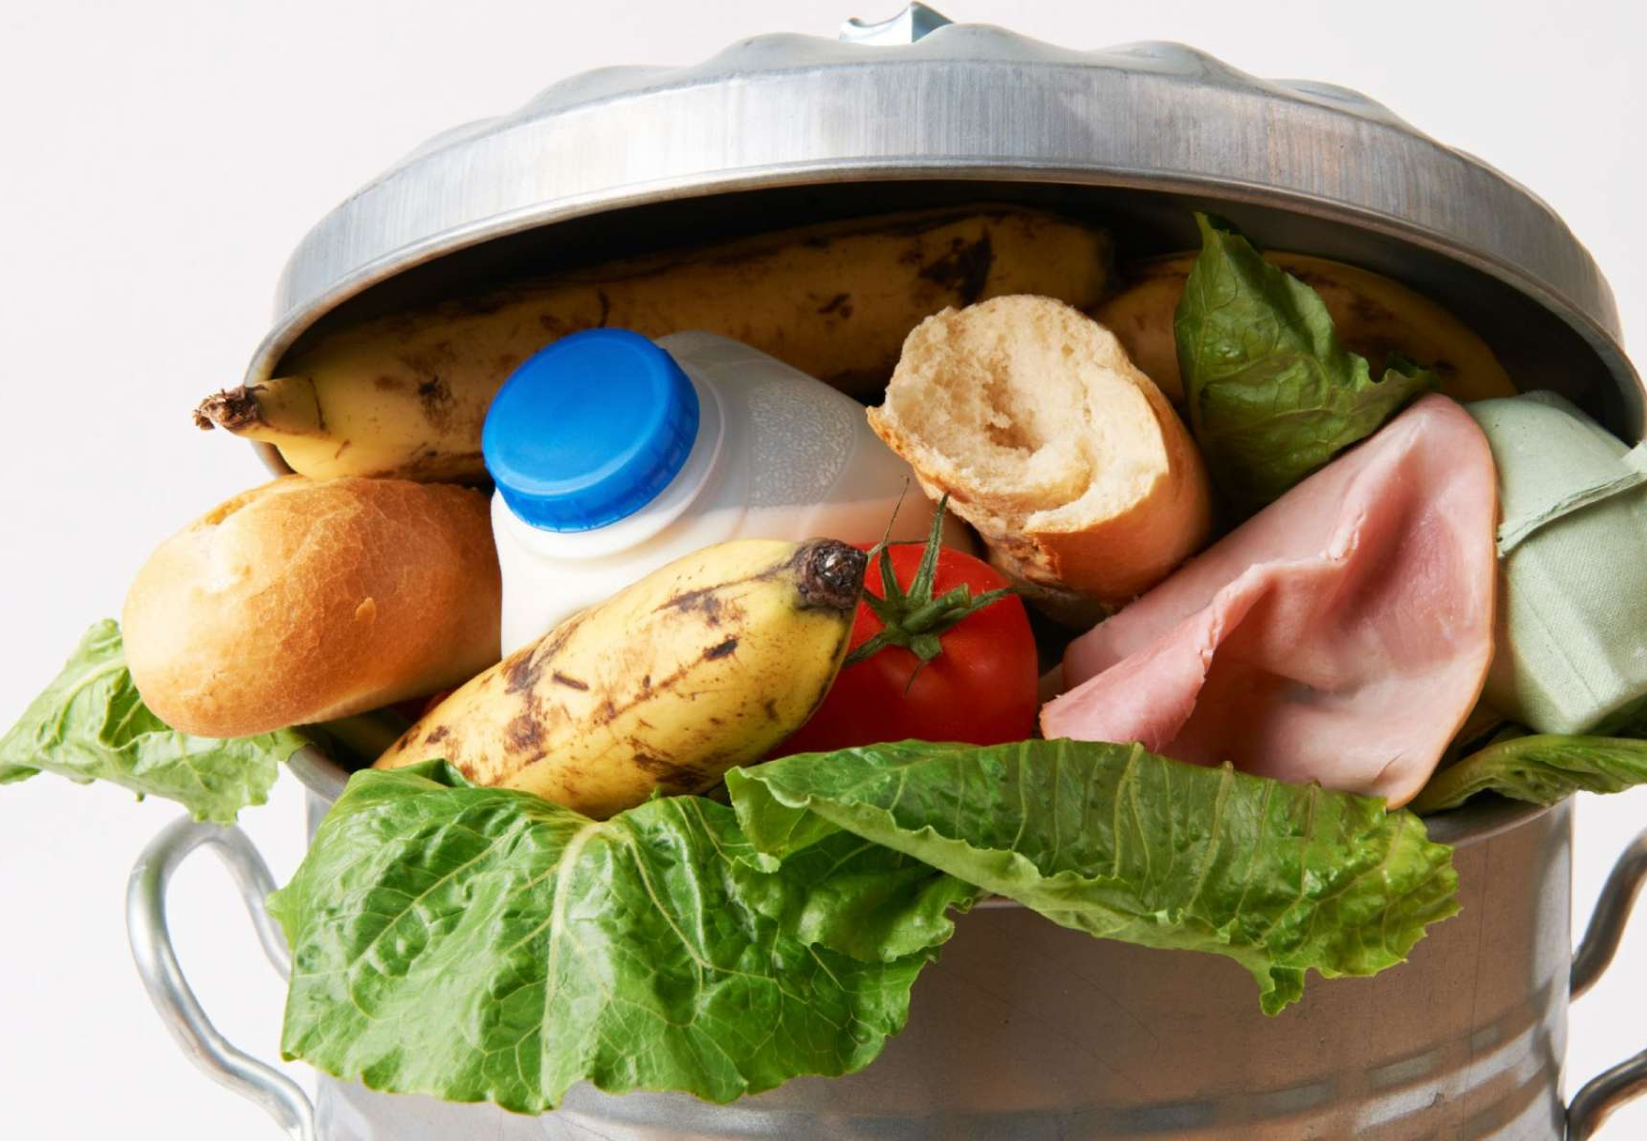
The Average Family Of Four Wastes 25% Or $2,000 A Year On Food
(National Resource Defense Council, 2017)

Slide 5

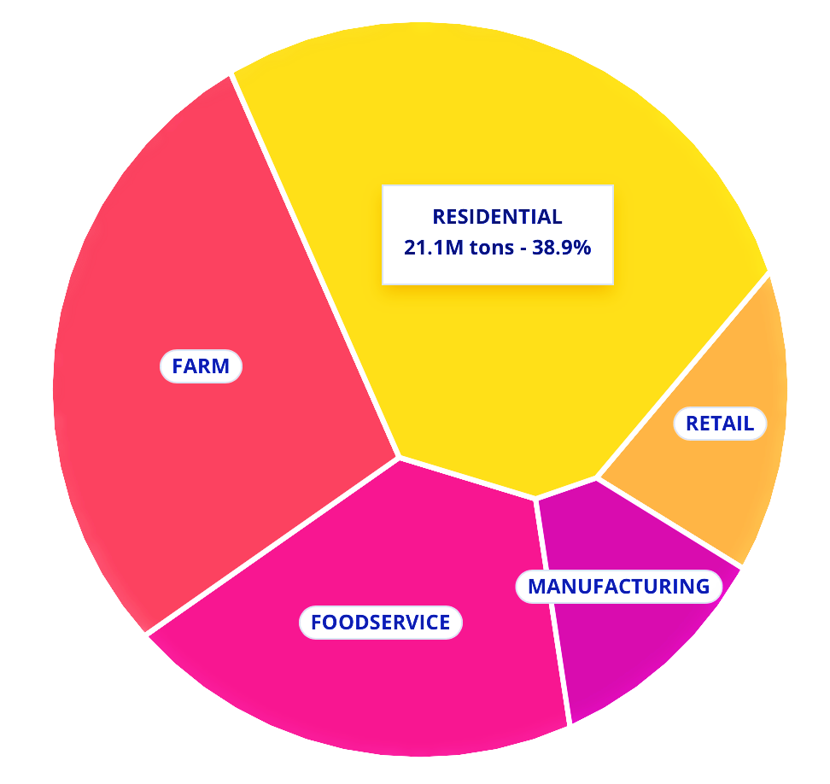
Data From U.S. 2019
54.2 Billion Kilograms of Food Waste
Enough to Feed 250 Million People Globally, 25% of World Hunger
(ReFED, 2021)

Slide 6
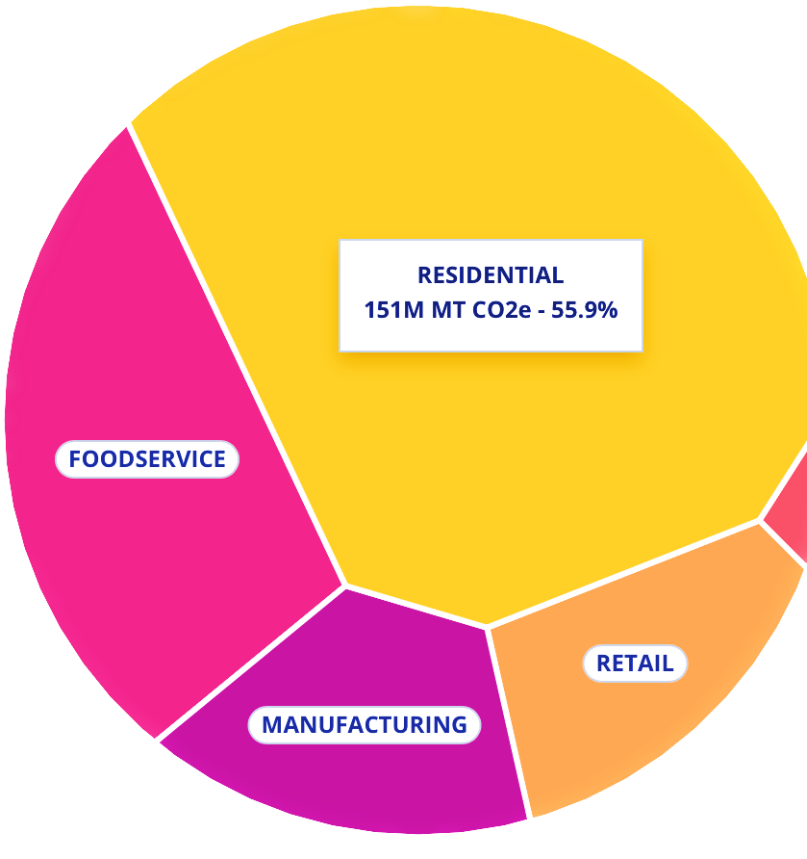
Data From U.S. 2019
270 Million Metric Tons of CO2
Greater Than That Of
The Airline Industry
(ReFED, 2021)

Slide 7
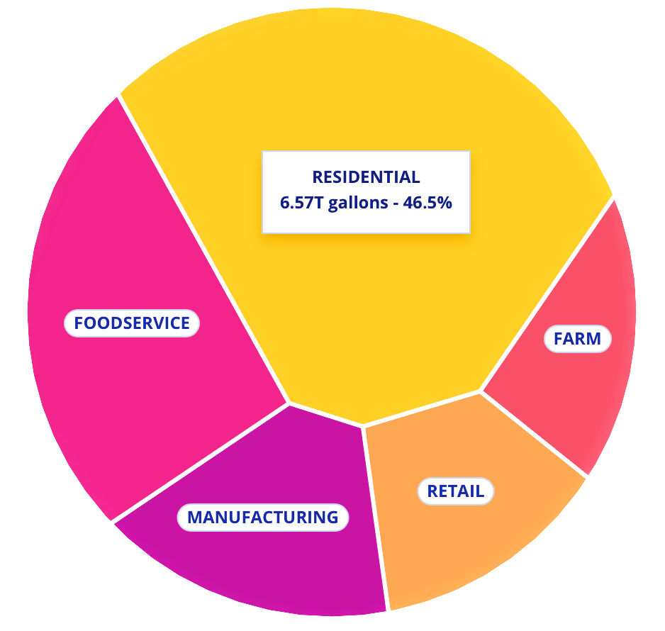
Data From U.S. 2019
14.1 Trillion Gallons of Water
Enough Water for 500 Million People
(Yunusa et al., 2018)
(ReFED, 2021)

Slide 8




ZeroWaste
Track Your Groceries,
Fight Hunger,
Save The Planet
The Cyber Savvy Ninjas

Slide 9
ZeroWaste
Grocery & Meal Planning
Expiry Date Timeline & Alerts
Stakeholder Partnership
Donations to Food Banks

Slide 10
Development
Implementation
Risk Assessment
Evaluation
Zero
Waste

Slide 11
Easier App Navigation
Personalized Customer Service
AI Assistant
Customized Suggestions

Slide 12
App
Demo

Slide 13

Global Impact
Reducing Food Waste
World Hunger
Global Warming
Water Crisis
Helping Users Worldwide

Slide 14
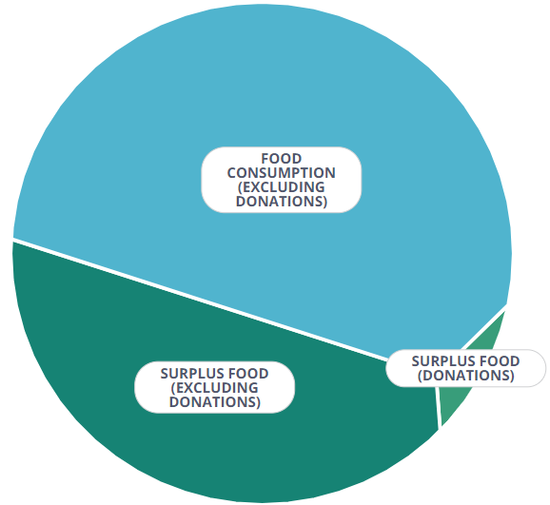
(Huang et al., 2020)
Helping Global Food Chains
Beyond 1/3 of Food Production is
Surplus

Slide 15
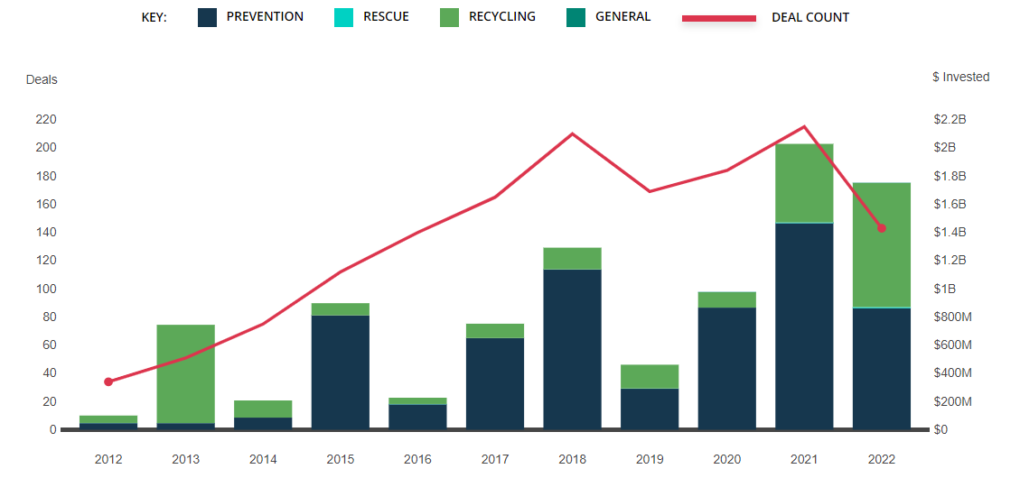
Investments Trendline
(U.S. Census Bureau, 2020)

Slide 16
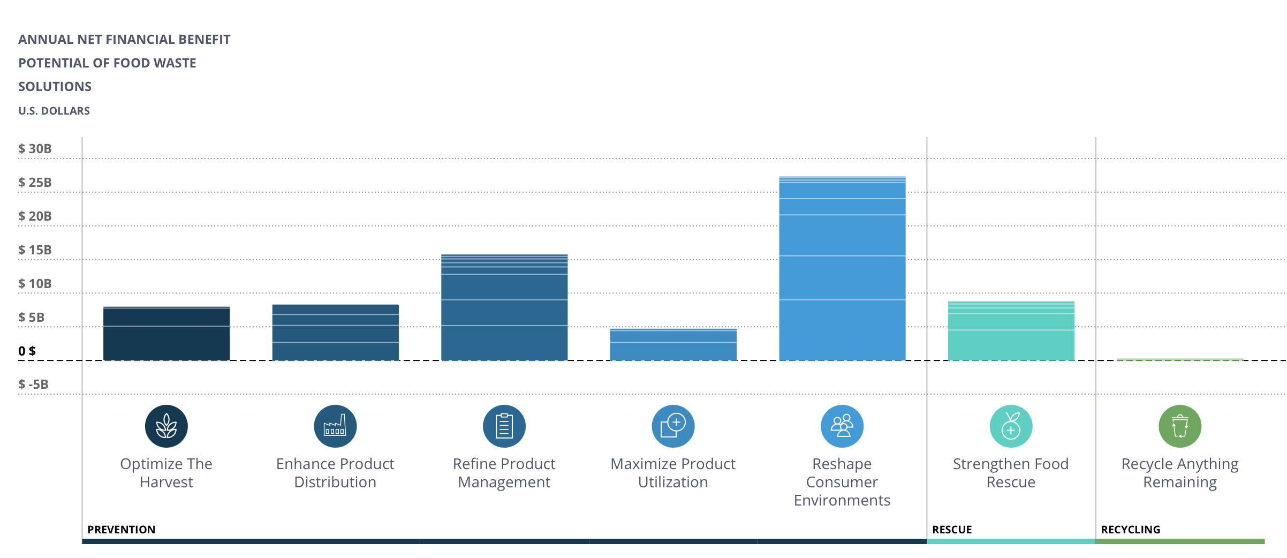
Targeting Largest Benefit
(U.S. Internal Revenue Service, 2020)

Slide 17
Financial Plan Overview
Personalized Ads
Utilize user food data for targeted advertising
Promote products relevant to user preferences, like discounted ingredients for favorite recipes
Gain a competitive edge over other apps
Strategic Partnerships
Collaborate with grocery stores to encourage customer loyalty through exclusive offers
Partner with food delivery services to redistribute expiring grocery store items to app users
Maximize app value with minimal resource investment
Virtual Nutritionist
Provide 24/7 AI-powered, personalized nutritional guidance
Continually adapt advice based on users' changing dietary habits
Leverage success stories to match users with similar situations and solutions
Offer a monthly subscription, including a free trial

Slide 18
Bibliography
Huang, C.-H., Liu, S.-M., & Hsu, N.-Y. (2020). Understanding global food surplus and food waste to tackle economic and environmental sustainability. Sustainability, 12(7), 2892. https://doi.org/10.3390/su12072892
Yunusa, I., Zerihun, A., & Gibberd, M. (2018). Analysis of the nexus between population, water resources and global food security highlights significance of governance and research investments and policy priorities: Governance and research investments as priorities for food security. Journal of the Science of Food and Agriculture, 98(5). https://doi.org/10.1002/jsfa.9126
Natural Resources Defense Council. (2017, October 25). Two-thirds of food wasted at home in three major U.S. cities is edible. Be a Force for the Future. https://www.nrdc.org/press-releases/two-thirds-food-wasted-home-three-major-us-cities-edible
U.S. Census Bureau. (2020). Annual retail trade survey: 2018. https://www.census.gov/data/tables/2018/econ/arts/annual-report.html
U.S. Internal Revenue Service. (2020). Form 990-PF. https://www.irs.gov/charities-non-profits/form-990-series-downloads
ReFED. (2021, January 22). Food waste monitor. https://insights-engine.refed.org/food-waste-monitor?view=overview&year=2019

Slide 19
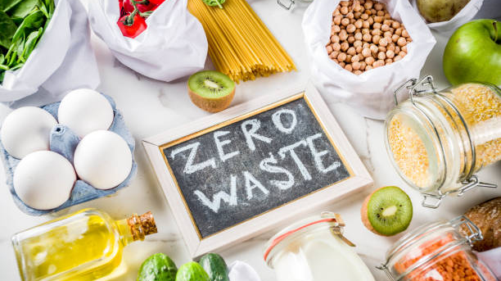
Thank You!

